Slide 1

Composite Application Guidance Prism 2
A Rainbow of Possibilities

Slide 3

Why Prism?
Loose Coupling of parts
Configurability
Composability
Higher Testability
Multi-Platform (WPF vs Silverlight)

Slide 4


What is Prism?
Composite Application
Guidance
Composite Application
Library

Slide 5

Take what you want

Slide 6
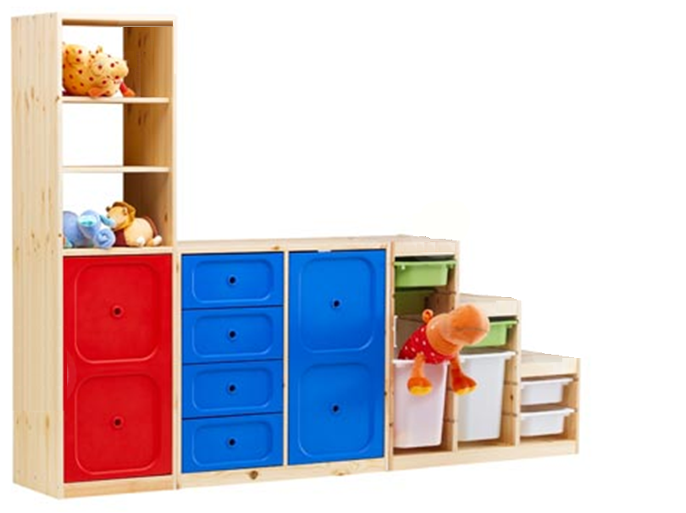
What is Composability?

Slide 7
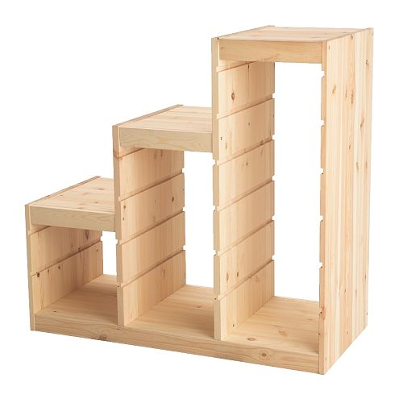
Start With a Shell

Slide 8
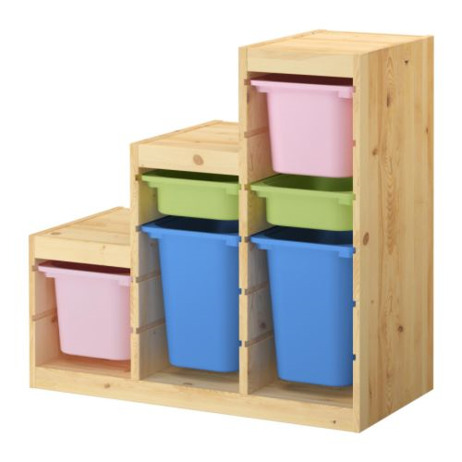
Add Modules Dynamically

Slide 9
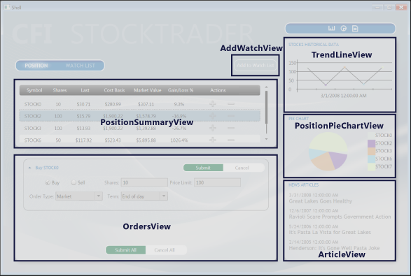
UI Composition
Position Module
Watch Module
Market Module
News Module

Slide 10
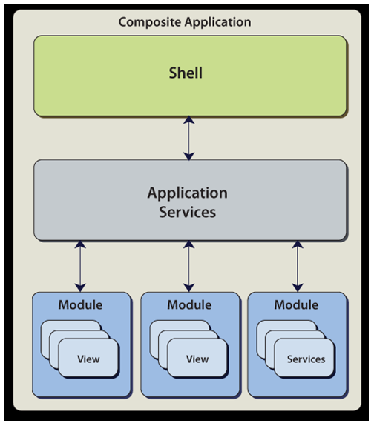
Modularity

Slide 11
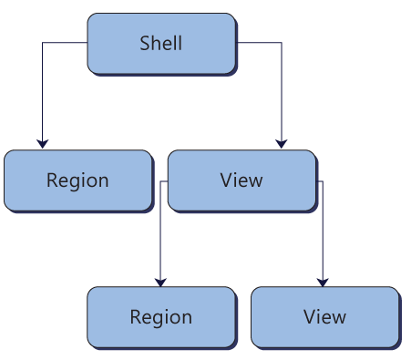
Nested Modules/Regions

Slide 12
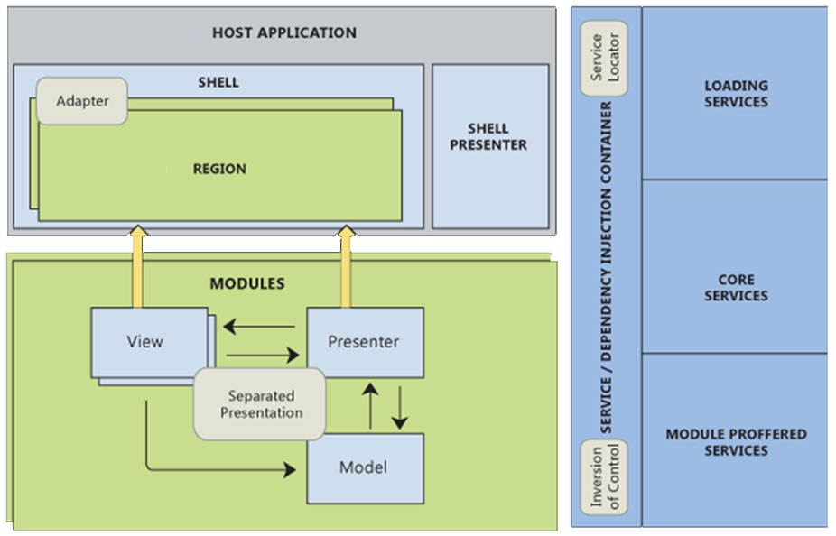
Implementation

Slide 13
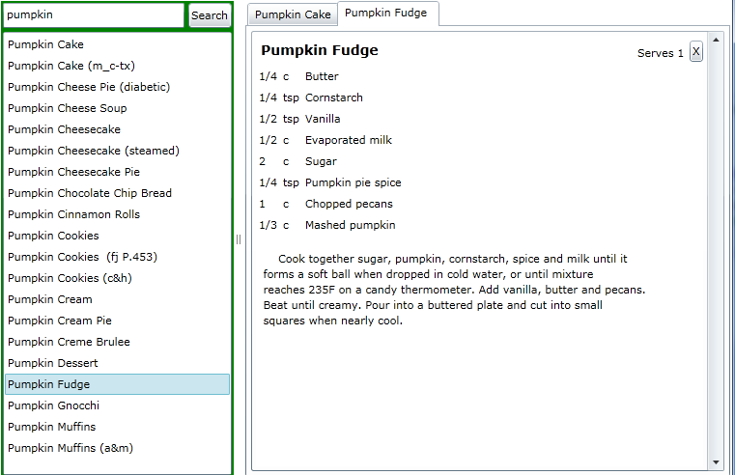
Demo

Slide 14

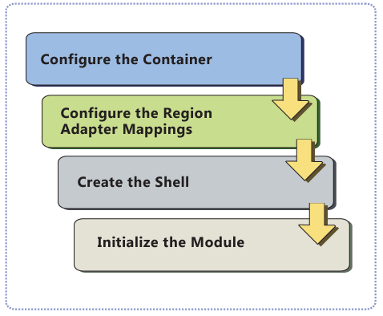
Bootstrapper
Notes:
Show how CreateShell relates to App.xaml.cs

Slide 15

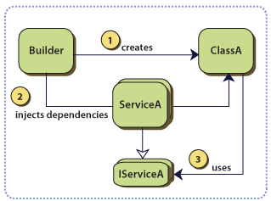
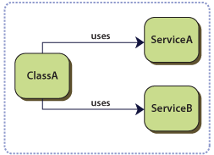
Dependency Injection
Notes:
Who uses it? Everyone!
Modules, Views, ViewModels, Presenters, etc

Slide 16

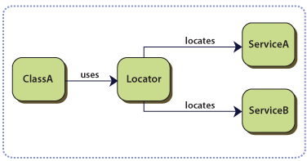
Service Locator
Notes:
Show with Navigator VM:
ServiceLocator.Current.GetInstance<>();

Slide 17

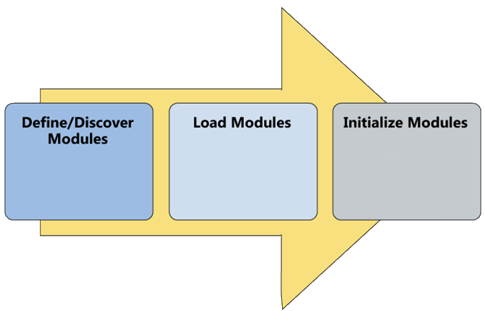
Modules

Slide 18

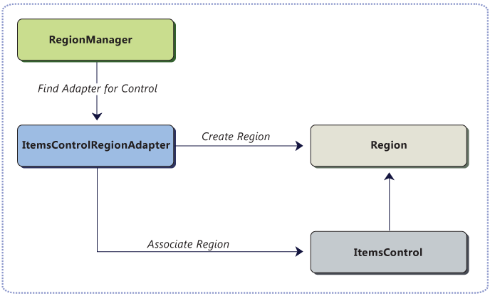
Region Manager
Notes:
View Discovery
View Injection

Slide 19
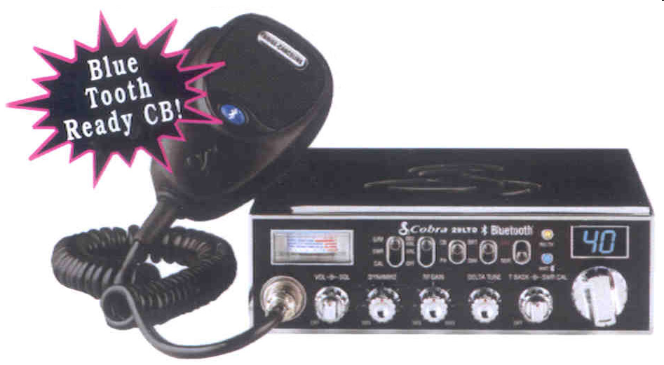
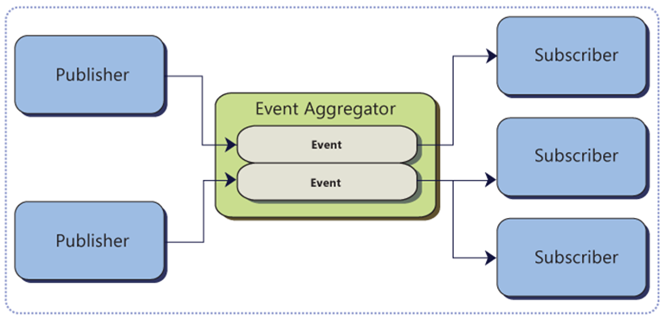
Event Aggregator
Notes:
Data bus
Fire and forget

Slide 20

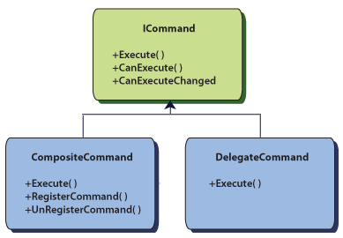
Commands

Slide 21

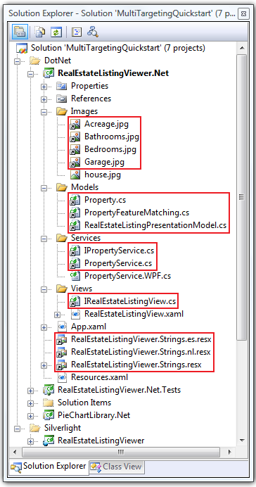
Multi-Targeting

Slide 22
Revisiting the Stock Trader

Slide 23

Where Do I Start?
Download the CAL
Create the Bootstrapper
Wire up the Bootstrapper
Create Modules
Wire up the Modules

Slide 24

Why Not?
Just a reference implementation
Patterns & Practices vs Mainline
A lot of ceremony for small apps
They do some things poorly

Slide 25
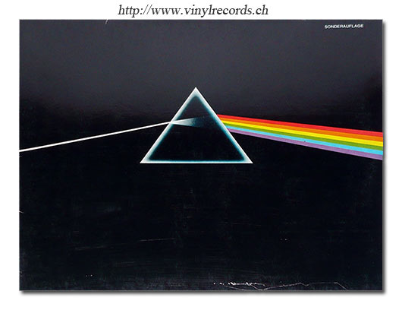
In Summary
A great library for building composite applications
Take parts if you want
Re-write parts if you want
Rock on with your bad self

Slide 26

Resources
Composite Application Guidance -- http://tinyurl.com/Prism2
Composite Application Library -- http://tinyurl.com/Prism2-CAL
CodePlex -- http://www.codeplex.com/CompositeWPF/
4-part video series -- http://tinyurl.com/Prism2-Videos
My Blog: http://HouseOfBilz.com
Twitter: http://twitter.com/BrianGenisio

